Slide 1

AI-Powered Emergency Vehicle Traffic Optimization
Accelerating first responders' arrival times through smart traffic management
Team: Bug-Busters

Slide 2
Methodologies
Real-Time Data Acquisition
Machine Learning Algorithms
Dynamic Traffic Signal Control
CNNs process traffic surveillance images to detect emergency vehicles accurately, distinguishing them from regular traffic. By integrating CNN-based classification with intelligent traffic control systems, traffic signals can dynamically adjust to provide clear paths for emergency responders. This approach enhances urban mobility, reduces congestion, and ensures that emergency services reach their destinations swiftly and efficiently.
Sensors, cameras, and GPS data
Prioritize emergency vehicle routes

Slide 3
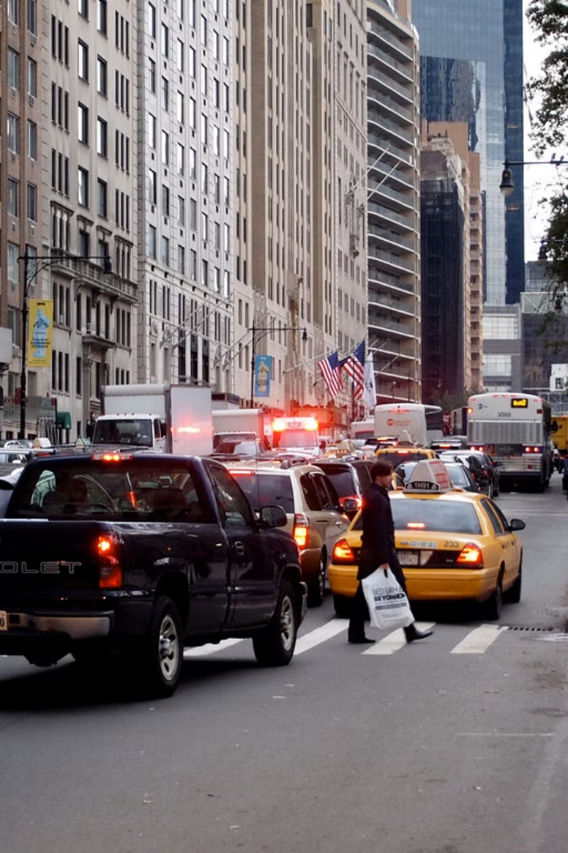
Challenges
Congestion
Unpredictable Events
Smart traffic signals and route optimization
Real-time data and dynamic route adjustments
Limited Communication
Enhanced communication between first responders and traffic control

Slide 4
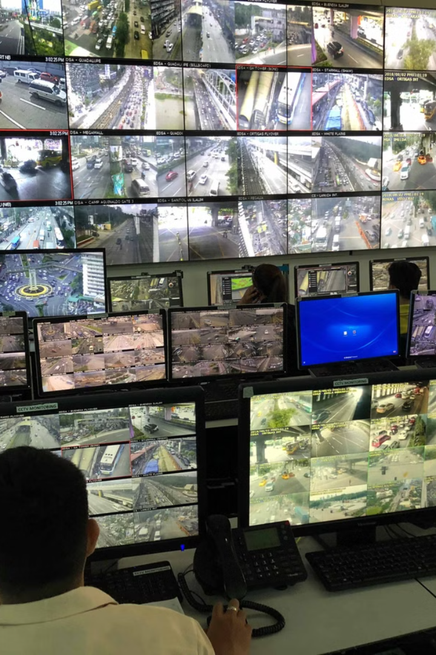



Real-Time Monitoring and Predictive Analytics
Traffic Flow Visualization
Predictive Analytics
Real-time traffic density maps
Anticipating congestion and potential delays
ETA Optimization
Accurate estimated arrival times

Slide 5




Implementing the Solution: Challenges and Opportunities
Data Privacy
1
Protecting sensitive traffic data
Integration with Existing Systems
2
Connecting with existing traffic infrastructure
Public Acceptance
3
Addressing concerns about potential disruption
Ongoing Development
4
Continuously improving the system's accuracy

